Slide 1
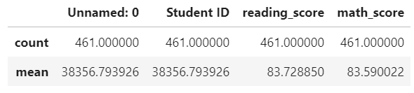
District Summary (with scores from 9th graders at THS)
District Summary (without scores from 9th graders at THS)
9th graders at THS

Slide 2
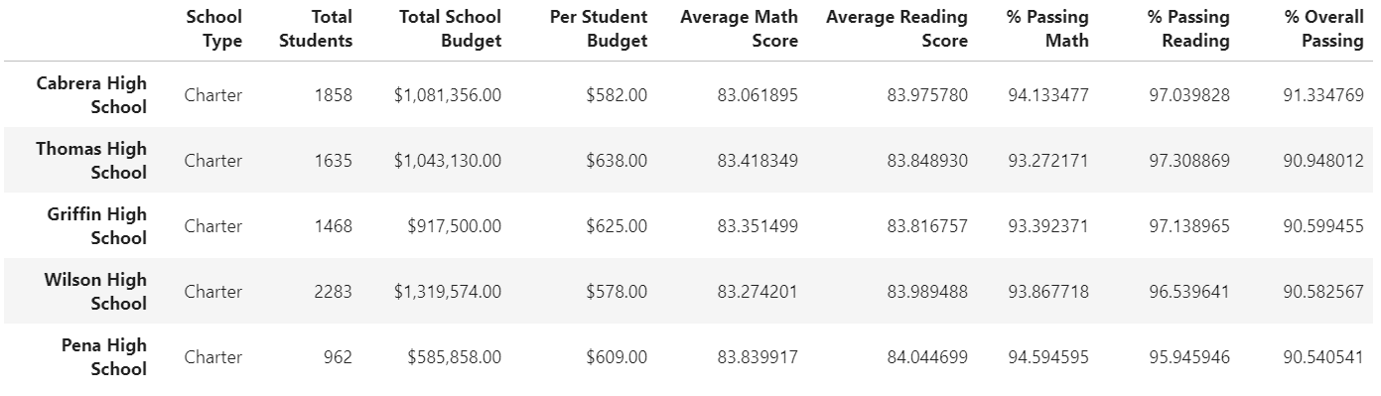
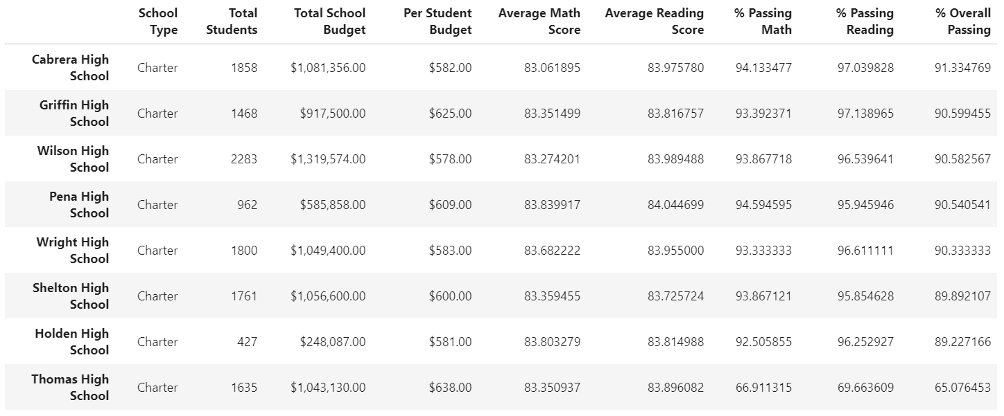
Top 5 Schools (with scores from 9th graders at THS)
Rank of THS (Without scores from 9th graders at THS)

Slide 3
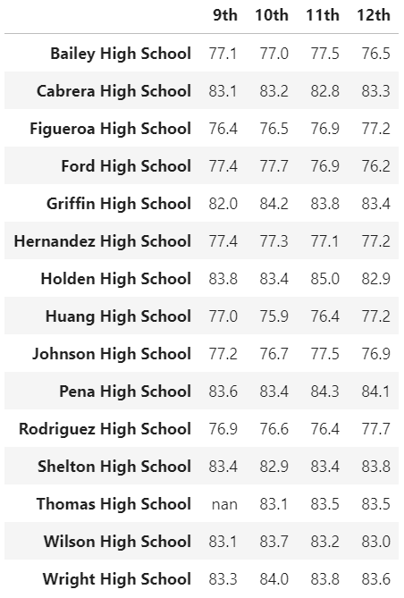

Results by Grade
Math
Reading

Slide 4
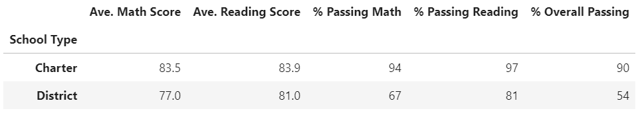
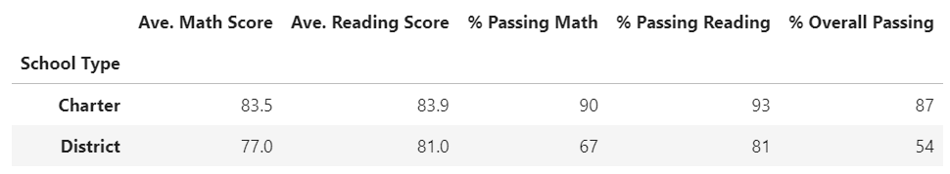
Summary by Type (with scores from 9th graders at THS)
Summary by Type (without scores from 9th graders at THS)

Slide 5
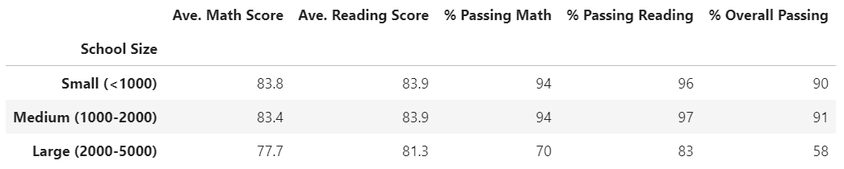
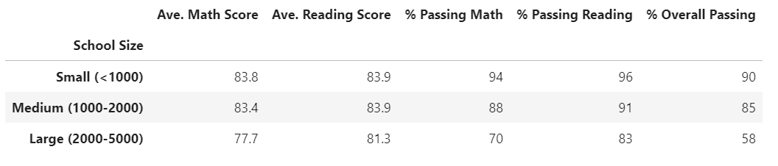
Size Summary (Before Cleanup)
Size Summary (9th NaN)

Slide 6
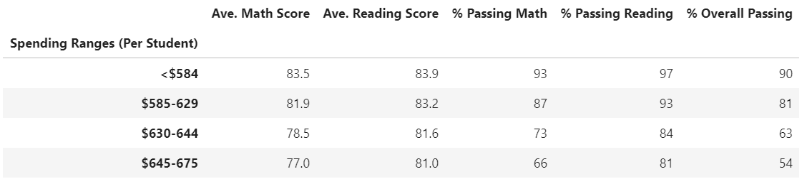
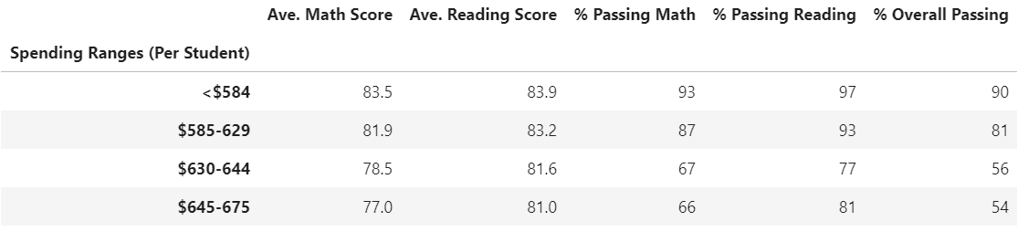
Summary by Spending (with scores from 9th graders at THS)
Summary by Spending (without scores from 9th graders at THS)

